Slide 1
Online Electronics Shopping System

Slide 2
Group Information
Group No : 5
Enrolment No. | Name
205220694081 | Saifullah Rahimi
205220694004 | RahulKumar M Zala
205220694005 | Rakesh Kumar

Slide 3
Contents
Introduction
Existing System
Need for the new System
Objective of the new System
Problem Definition
Core Components
Project Profile
Assumptions and Constraints
Advantage and limitation of proposed system
Use Case Diagram

Slide 4
Class Diagrams
Sequence Diagram
Activity Diagram
DFD Diagrams
Data Dictionary
Admin Screen Layouts
Visitor Screen Layouts
Customer Screen Layouts
Future Enhancement
Conclusion

Slide 5
Introduction
The “Online Electronics Shopping System” will be a web-based application for “A to Z Electronics” which customers can easily buy a product using internet like smartphones, camera, mobile accessories etc.

Slide 6

Existing System
In current scenario, all the information related to the customer and their
orders are maintained manually.
Owner manage all the details of products manually.

Slide 7
Need for the New System
Maintaining registers is the biggest limitations of the current system.
Time consuming.
Preparing invoice manually takes extra time.
Data is not secure.

Slide 8
Objective of the New System
In our “Online Electronic Shopping System” will manage all the information related to the customer and their orders are maintained dynamically.
So, this is very useful for owner to manage all the information of products and customer’s orders.

Slide 9

Problem Definition
The Project “Online Electronics shopping System” will be a web-based application which will allows several features such as stock management, Internet online booking, Online ordering via network, Customer management, Accounting etc.

Slide 10
Core Components
Admin: Admin will manage all the task like product management, manage categories etc.
Visitor: Visitor can view the products, and register in the system.
Customer: Customer can login in the system, place the order ,make the -
payment, cancel or return the order.

Slide 11
Project Profile
Project Name | Online Electronics Shopping System
Framework | Laravel
Operating System | Windows 10
Front End | HTML, CSS, JavaScript, Bootstrap, jQuery, Ajax
Back End | MySQL 5.5.24
Web Server | Xampp 7.4.20
Diagram Tool | MS Visio professional 2013, Visual Paradigm 8.0
Presentation Tool | Microsoft PowerPoint 2016

Slide 12
Assumptions and Constraints
Assumptions:
Every client wants a fast, responsive and best service from website, if time support so will also provide the product return and login process using user name and password facilities to the users.
Constraints:
Client should be happy with the service.
Client should easily get appointment

Slide 13
Advantages and Limitations of the Proposed System
Advantages:
The Customers can purchase the products from anytime and anywhere.
Required Invoice & Reports can be generated easily.
Data will be Secure.
Real-time information of availability of product.
Save the customer’s time.
24*7 Service availability.
Limitations:
Internet bandwidth.
Takes time for delivery.

Slide 14
Use Case Diagrams

Slide 15
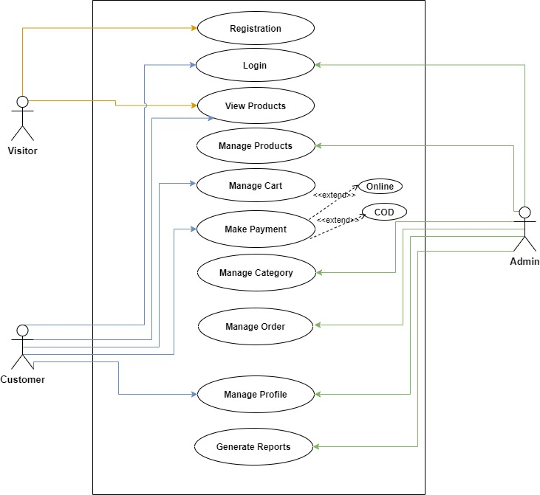

Slide 16
Class Diagrams

Slide 17
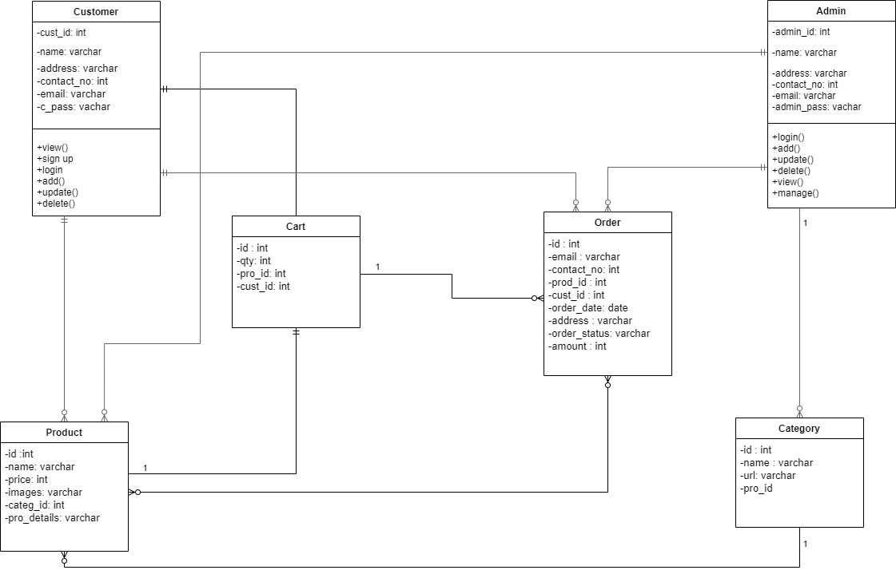

Slide 18
Sequence Diagrams

Slide 19
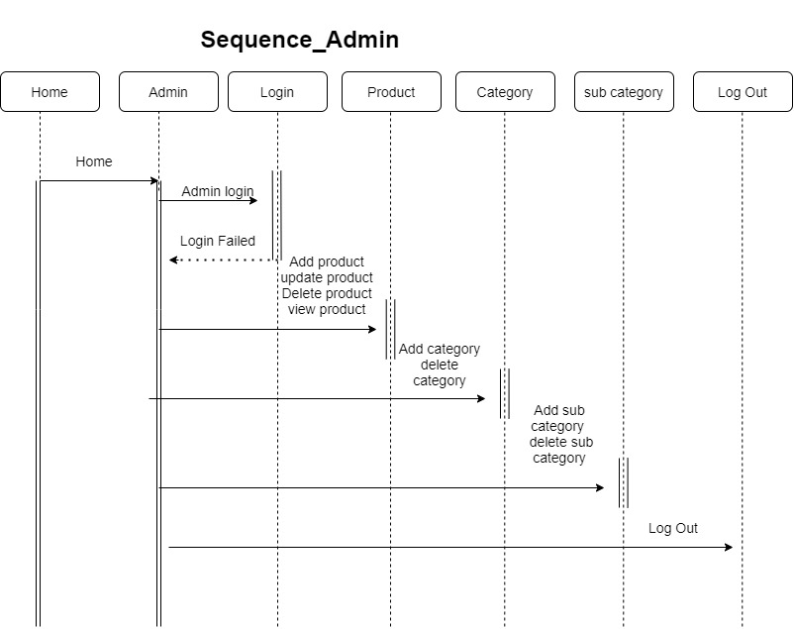
Admin:

Slide 20
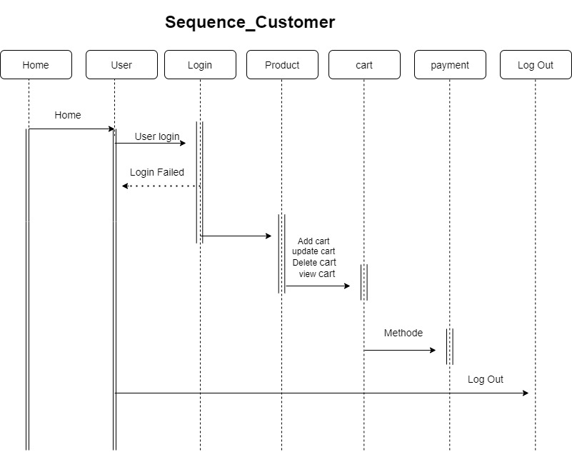
Customer:

Slide 21
Activity Diagram

Slide 22
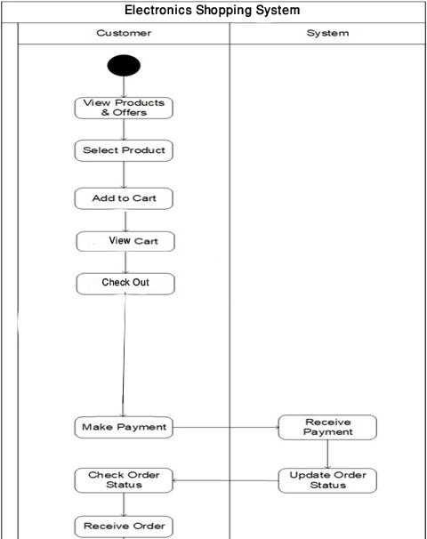
Place Order

Slide 23
DFD Diagram

Slide 24
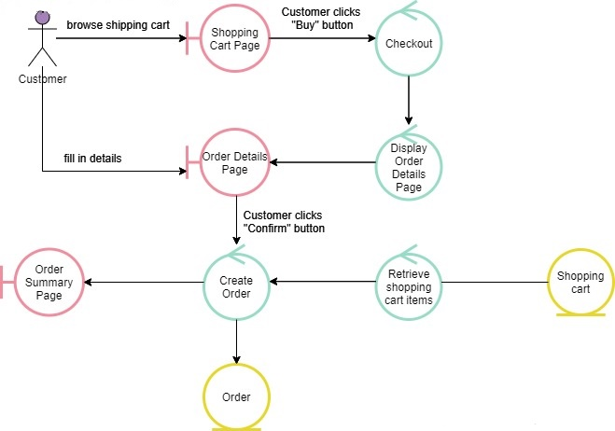
DFD Level 1:

Slide 25
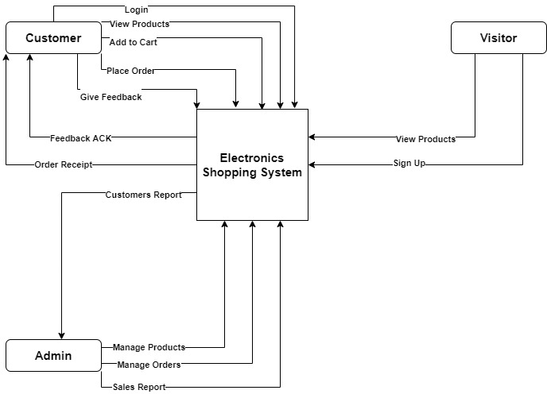
DFD Level 0:

Slide 26
Company
Description: It’s stores details of Company Table.
Field Name | Data Type | Constraint | Description | Sample Data
company_id | Tinyint(1) | Primary Key | Company id | 1
name | Varchar(30) | Not Null | Name of company | Online Electronics
address | Varchar(100) | Not Null | Address of company | A-10, Super Market
conctact_no | Bigint(13) | Not Null | Contact number of company | 9904557920
e-mail | Varchar(40) | Not Null | Email id of company | Onlineelectronics @gmail.com

Slide 27
Data Dictionary

Slide 28
Customer
Description: It’s stores details of Customer Table.
Field Name | Data Type | Constraint | Description | Sample Data
user_id | Mediumint(6) | Primary Key | User id | 1
name | Varchar(30) | Not Null | Name of Customer | Rahul
address | Varchar(255) | Not Null | Address of Customer | A-204,Bapunagar
contact_no | Bigint(13) | Not Null | Contact number of Customer | 9742612358
e-mail | Varchar(50) | Not null | Email id of Customer | rahulzala@gmail.com
password | Varchar(10) | Not null | Password of Customer | Eshgdjded854dednd(MD5 Format)

Slide 29
Category
Description: It’s stores details of Category Table.
Field Name | Data Type | Constraint | Description | Sample Data
cate_id | Smallint(3) | Primary Key | Category id | 1
parent_cate_id | Smallint(3) | Foreign Key | Reference Id of Category Table | 0 (Main Category)
name | Varchar(30) | Not Null | Category name | Mobile
url | Varchar(50) | Not null | URL of Category | mobile

Slide 30
Product
Description: It’s stores details of Product Table.
Field Name | Data Type | Constraint | Description | Sample Data
product_id | Smallint(3) | Primary Key | Id of Product | 1
category_id | Smallint(3) | Foreign Key | Reference Id of Category Table | 1
model_name | Varchar(50) | Not Null | Model name of Product | Redmi
description | Text | Not null | Description of Product | This is Redmi Mobile Phone
image | Varchar(100) | Not null | Images of Product | Redmi9pro.jpg

Slide 31
Cart
Description: It’s stores details of Cart Table.
Field Name | Data Type | Constraint | Description | Sample Data
cart_id | Smallint(3) | Primary Key | Cart id | 1
prodcut_attribute_id | Mediumint(3) | Foreign Key | Reference Id of Product Attribute Table | 1
customer_id | Smallint(3) | Foreign key | Reference Id of Customer Table | 1
qty | Tinyint(2) | Not Null | Quantity of Cart | 2

Slide 32
Order
Description: It’s stores details of Order Table.
Field Name | Data Type | Constraint | Description | Sample Data
order_id | Mediumint(6) | Primary key | Sales order id | 1
area_id | Smallint(3) | Foreign key | Reference Id of Area Table | 1
product_attri_id | Mediumint(3) | Foreign key | Reference Id of Product Table | 1
deliv_add_id | Mediumint(3) | Foreign key | Reference Id of Delivery Address Table | 1
customer_id | Smallint(6) | Foreign key | Reference Id of Customer Table | 1
address | Varchar(255) | Not Null | Address of Billing | Block no 4,Shahpur
flag(order no) | Int(7) | Not Null | Order Number | 7896153
order_status | Varchar(30) | Not Null | Delivery status of Billing | Shipped / Delivered
qty | Tinyint(2) | Not Null | Qty of Product | Shipped / Delivered

Slide 33
Sales
Description: It’s stores details of Sales Table.
Field Name | Data Type | Constraint | Description | Sample Data
sales_id | Mediumint(3) | Primary Key | Id of Sales | 1
order_id | MediumInt(3) | Foreign Key | Reference Id of Order Table | 1
sales_date | Date | Not Null | Date of Sales | 25-05-2020

Slide 34
Sales Return
Description: It’s stores details of Sales Return Table.
Field Name | Data Type | Constraint | Description | Sample Data
sales_return_id | Smallint(3) | Primary key | Id of Sales Return | 1
product_attribute_id | Mediumint(3) | Foreign key | Id of Product Attribute Table | 1
customer_id | Smallint(3) | Foreign key | Id of Customer Attribute Table | 1
sales_id | Mediumint(11) | Foregin key | Reference Id of Sales Table | 1
reason | Text | Not Null | Reason of Sales Return | Order in Wrong Address
sales_return_date | Date | Not Null | Date of Sales Return | 27-05-2020

Slide 35
Admin Screen
Layouts

Slide 36
Manage Login

Slide 37
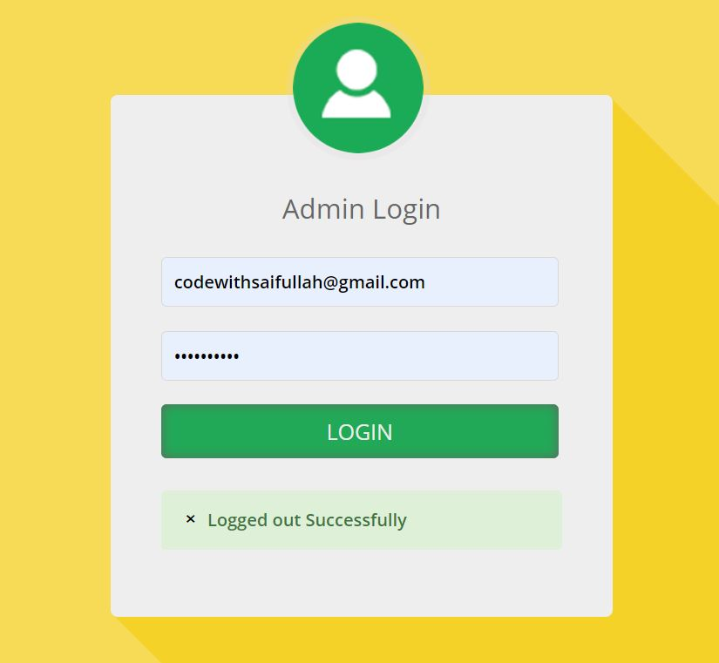
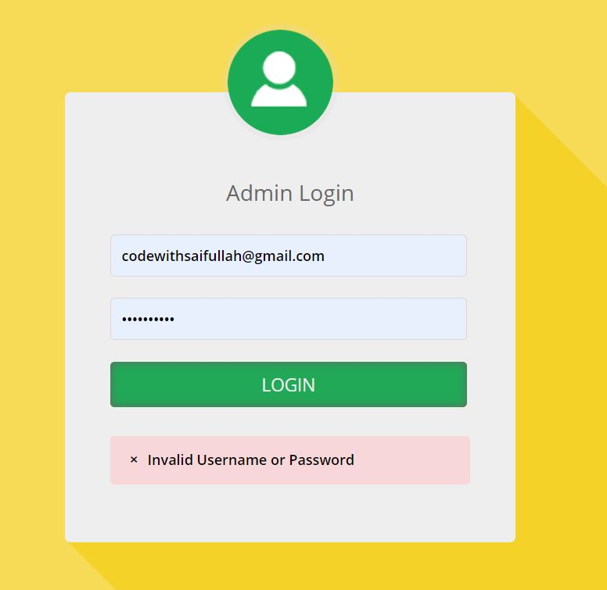
Login & Validation

Slide 38
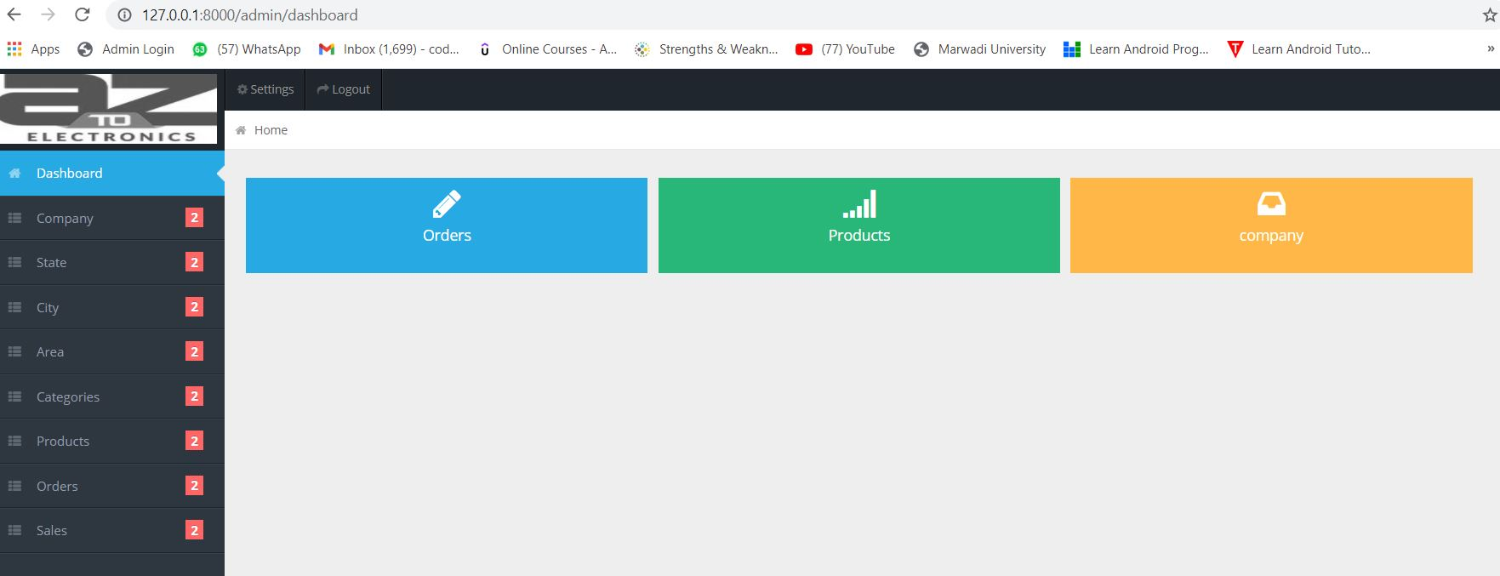
Admin Dashboard

Slide 39
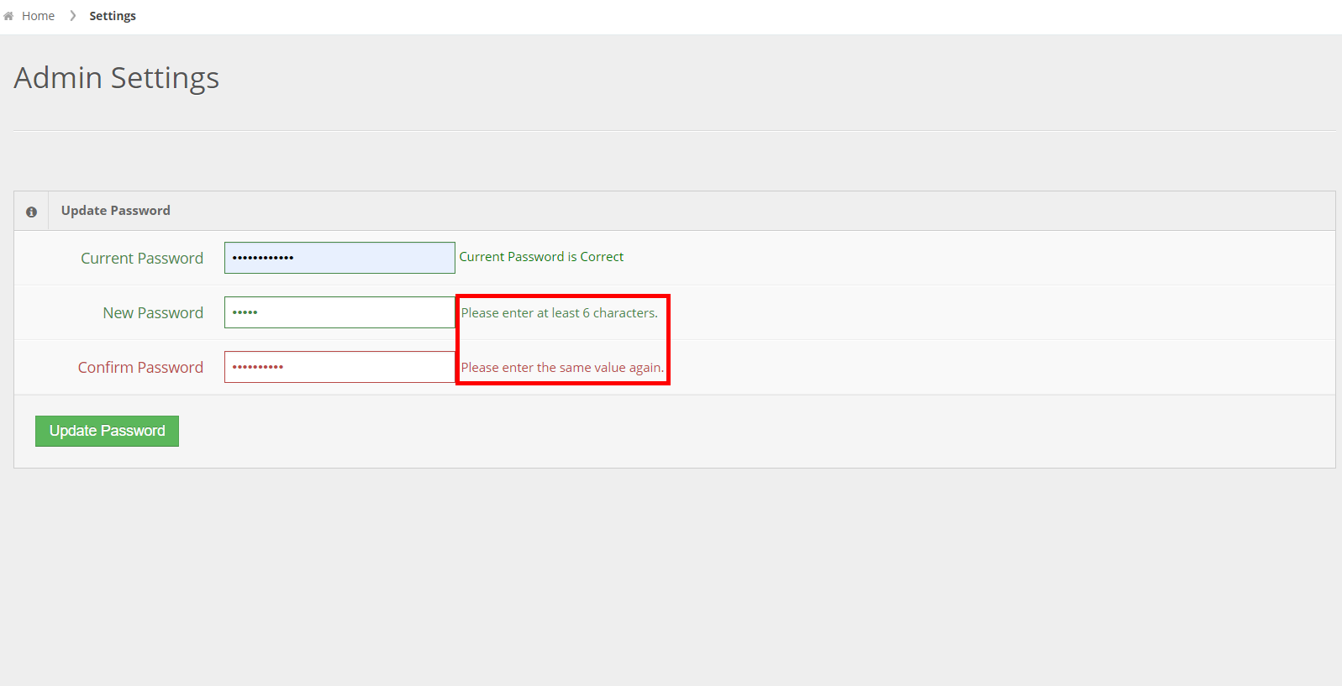
Change Password Validation

Slide 40
Manage Category

Slide 41
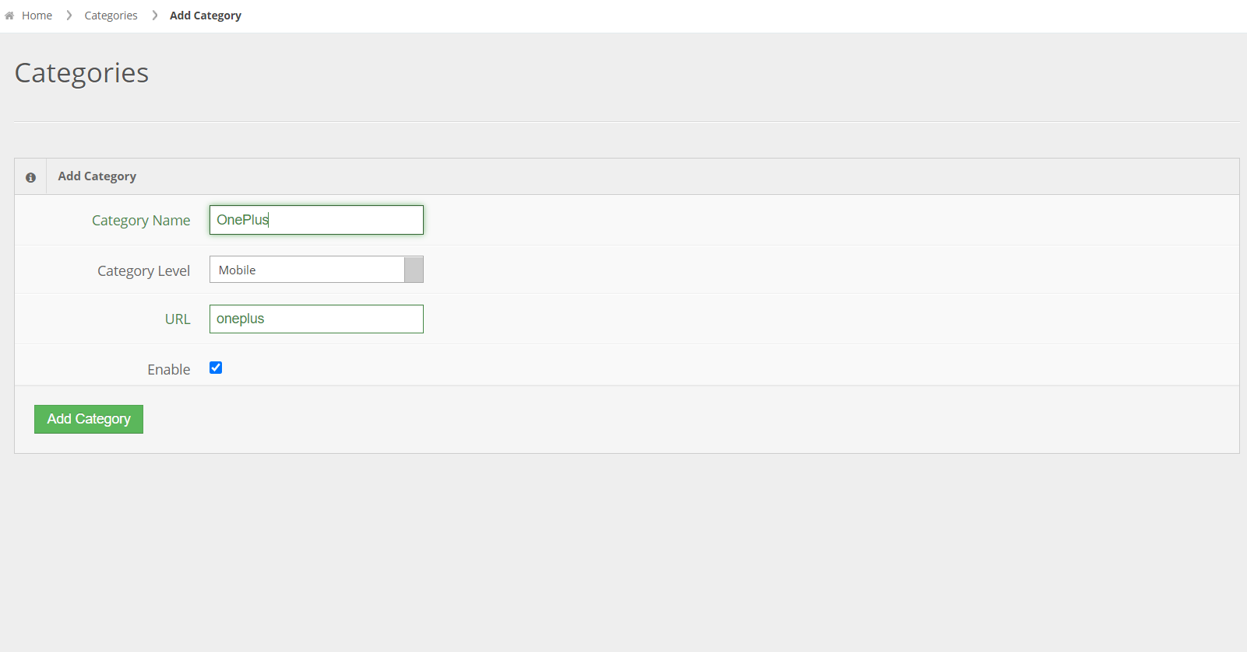
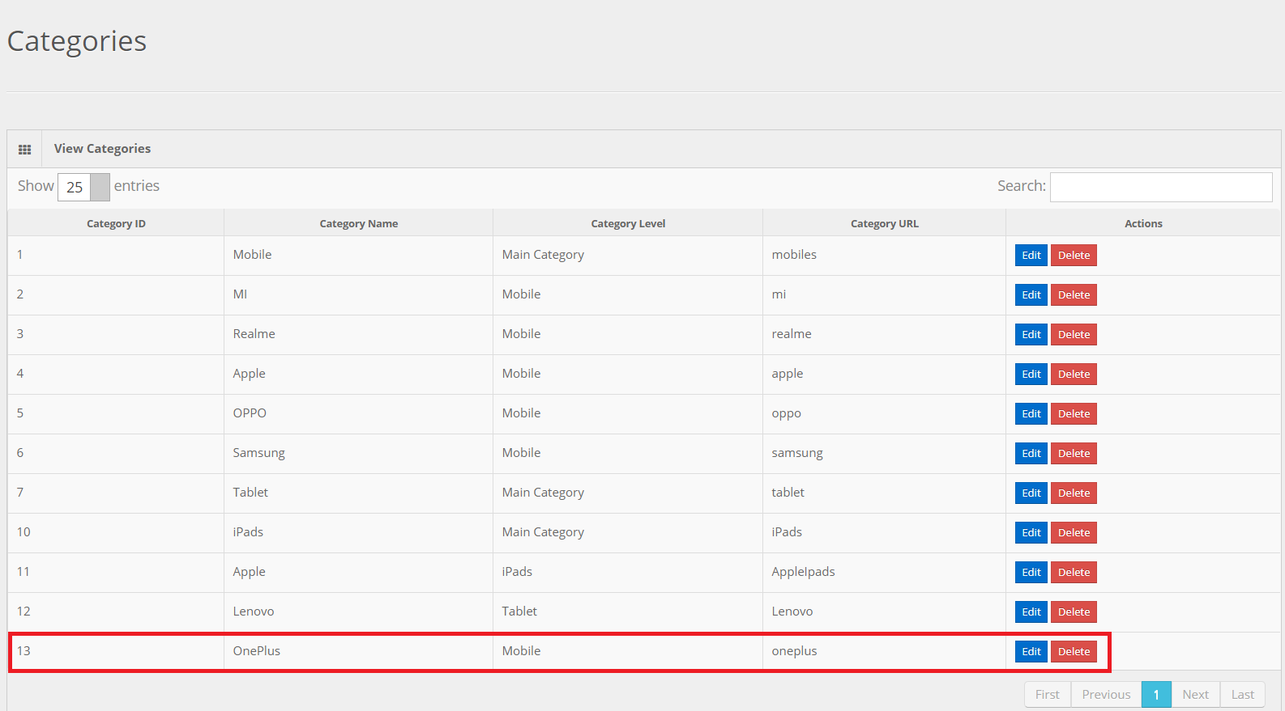
Add Category

Slide 42
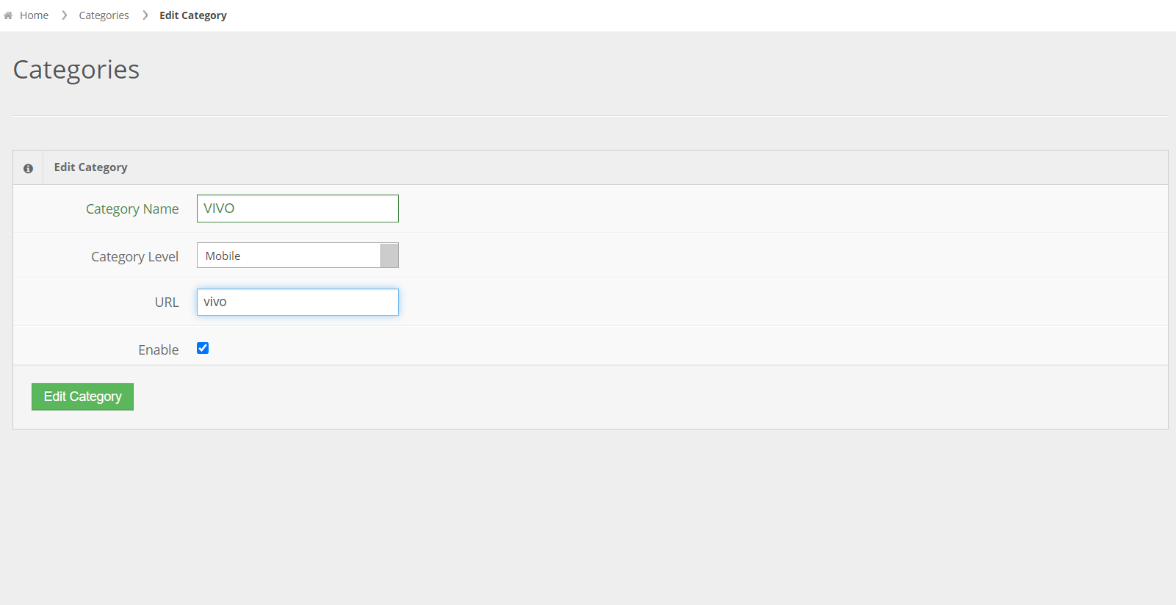
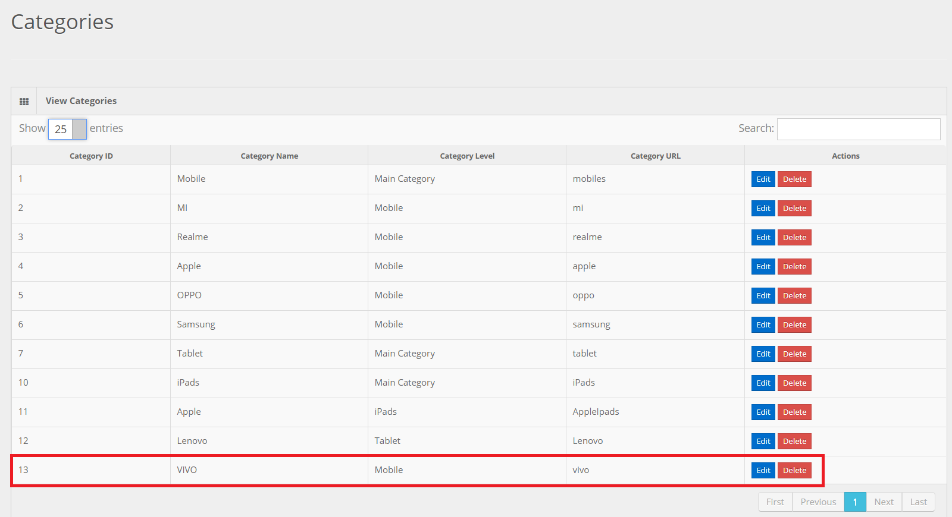
Update Category OnePlus to VIVO

Slide 43
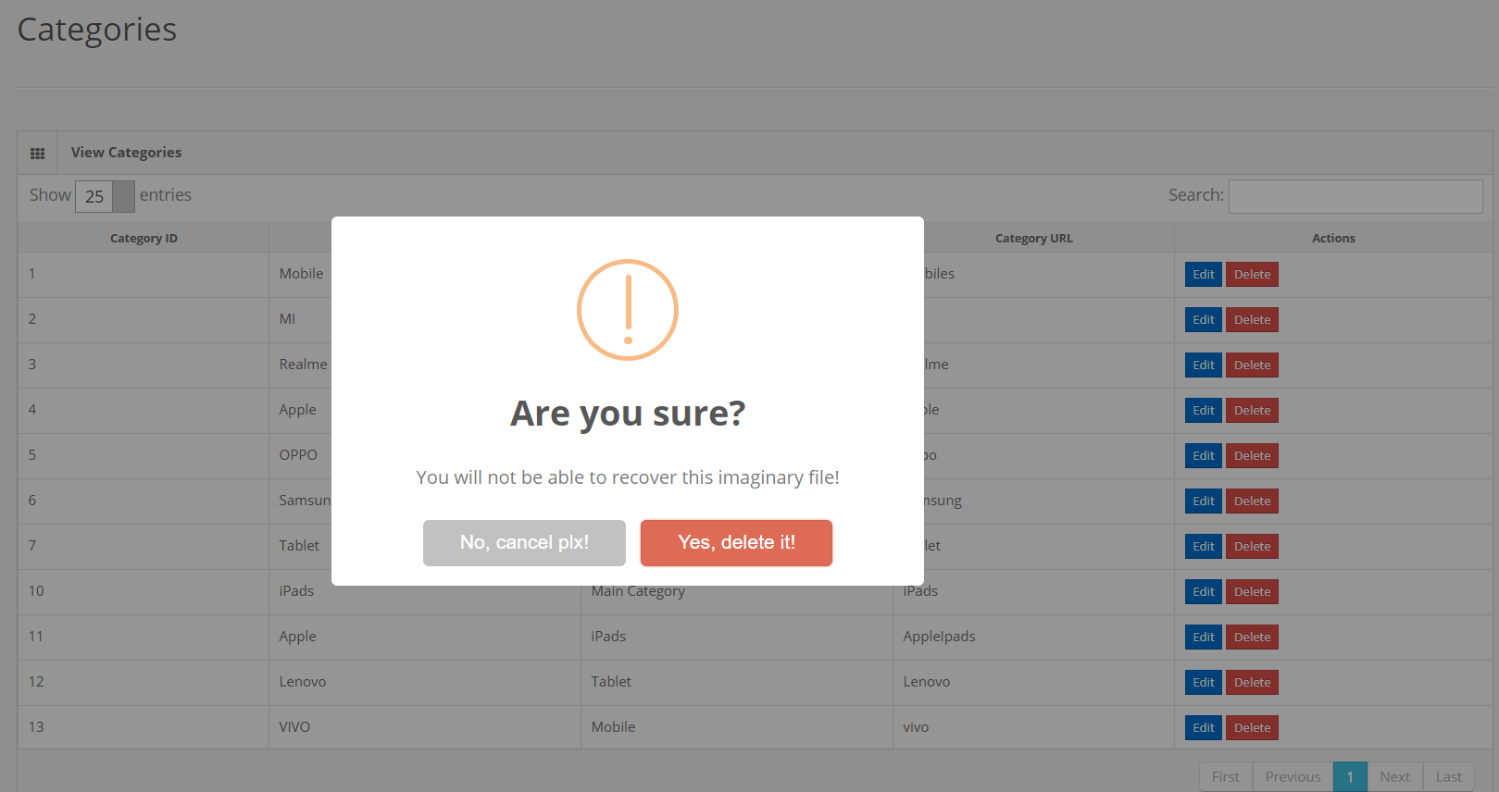
Alert Confirmation Message For Deletion

Slide 44
Manage Product

Slide 45
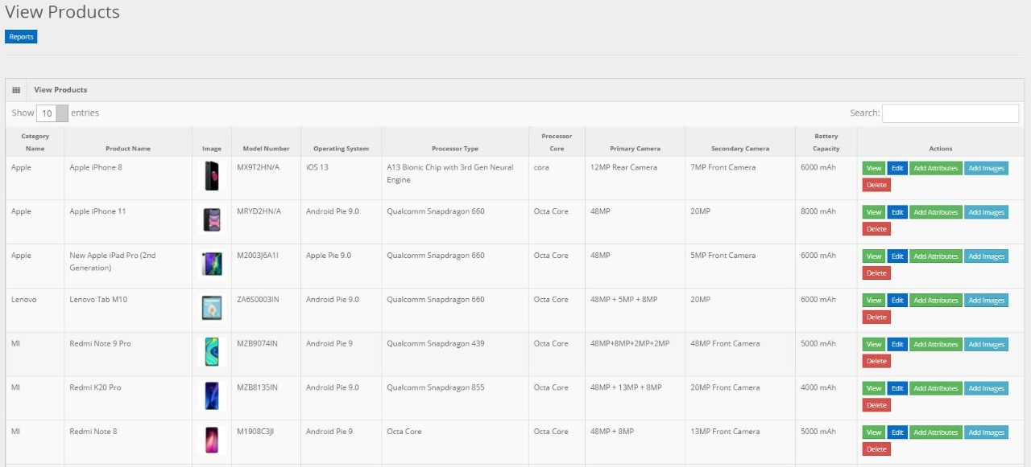
View Product

Slide 46
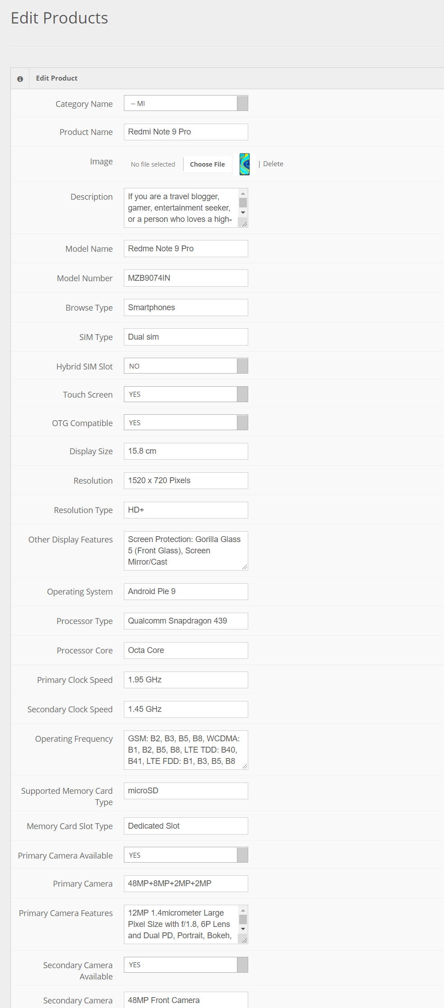
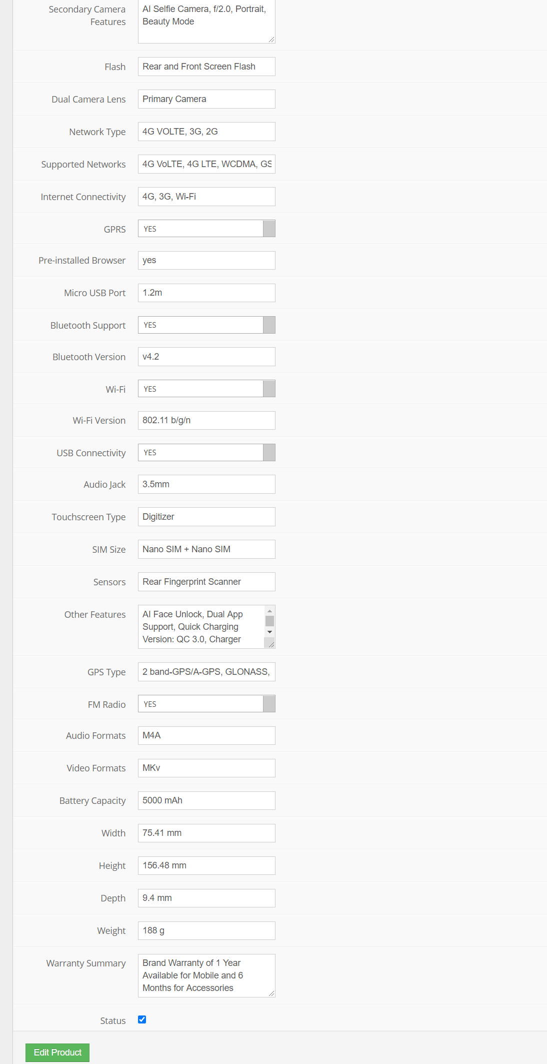
Edit Product

Slide 47
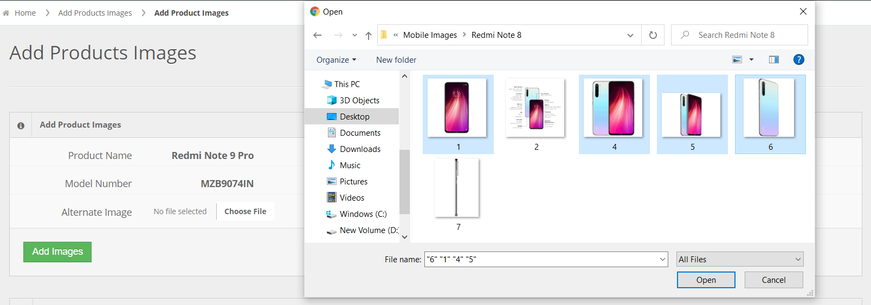
Insert Multiple Images

Slide 48
Manage Order

Slide 49
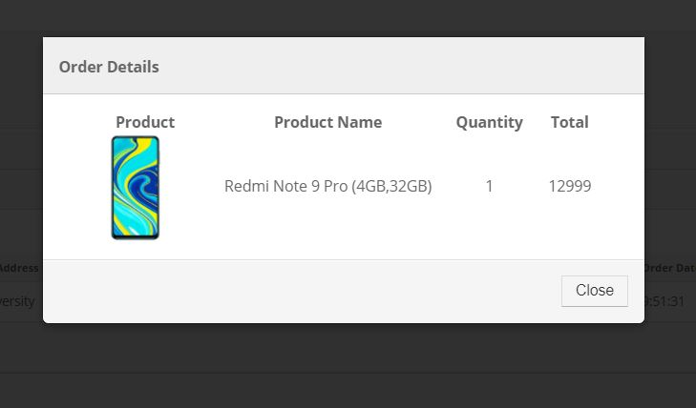
View Orders

Slide 50
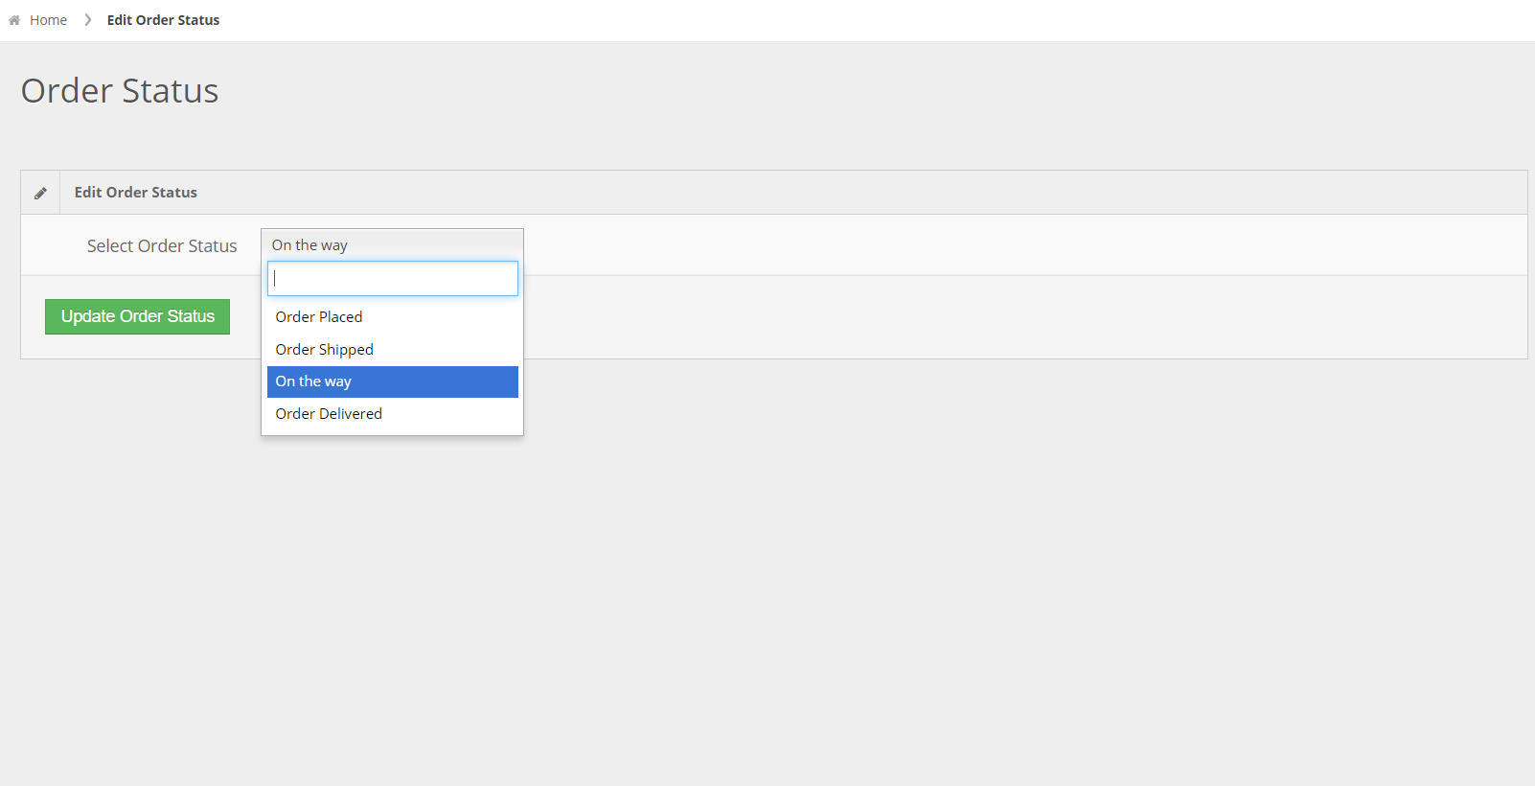
Update Order Status

Slide 51
Visitor Screen
Layouts

Slide 52
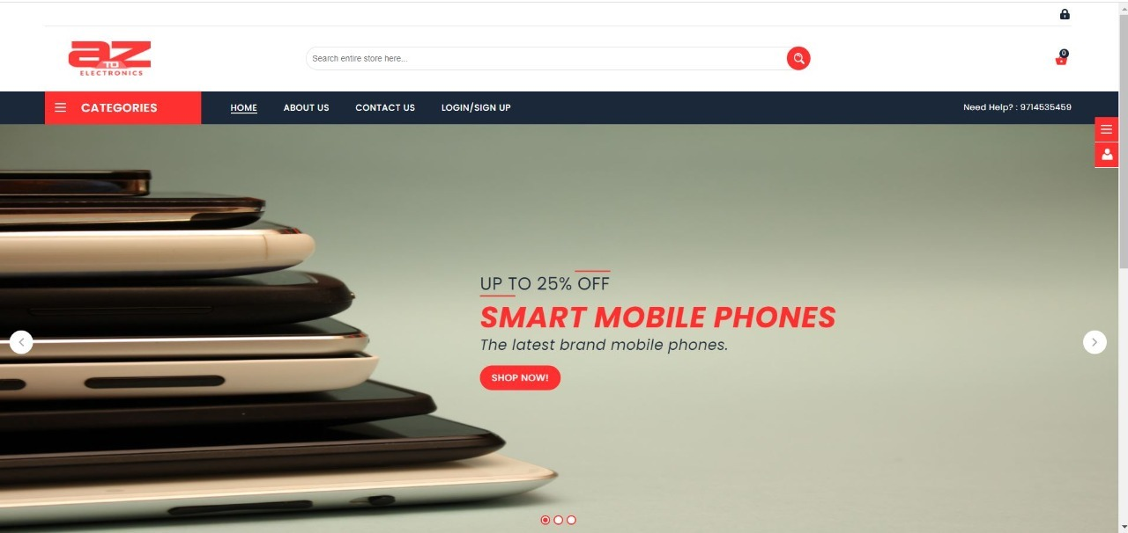
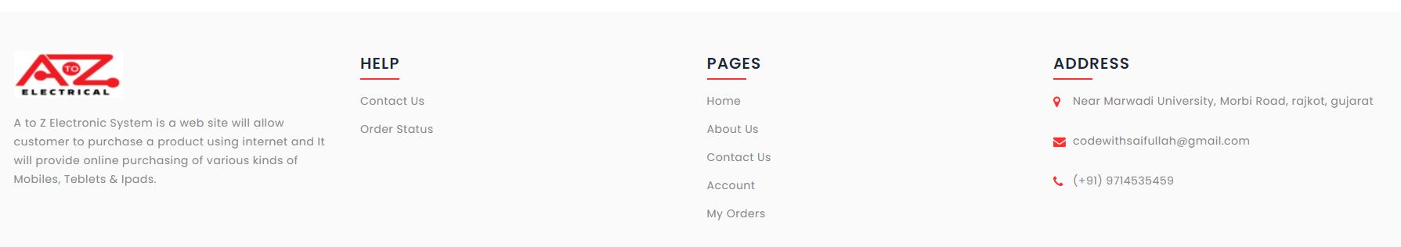
Header
Footer

Slide 53
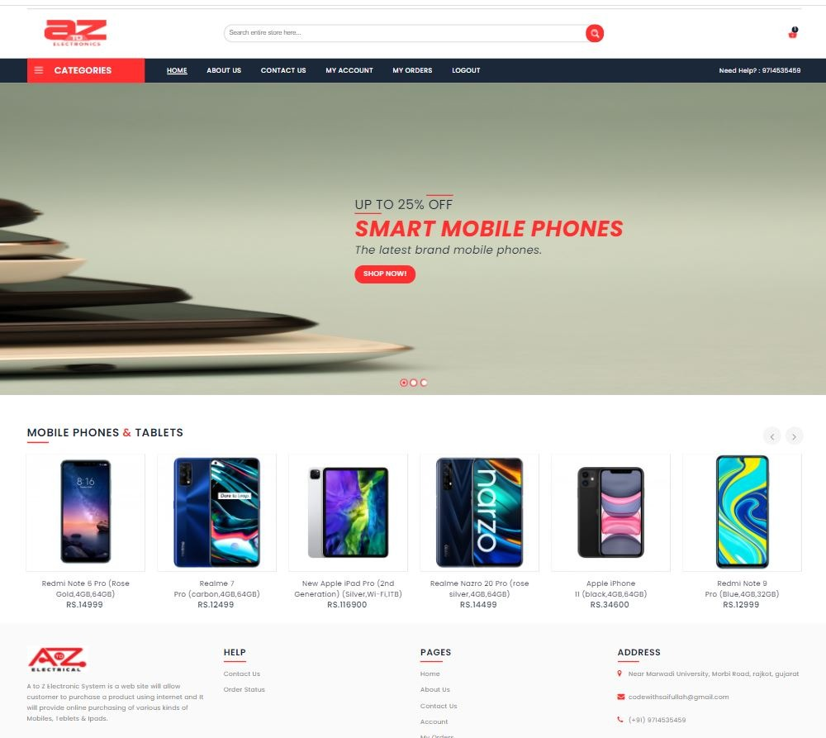
Home Page

Slide 54
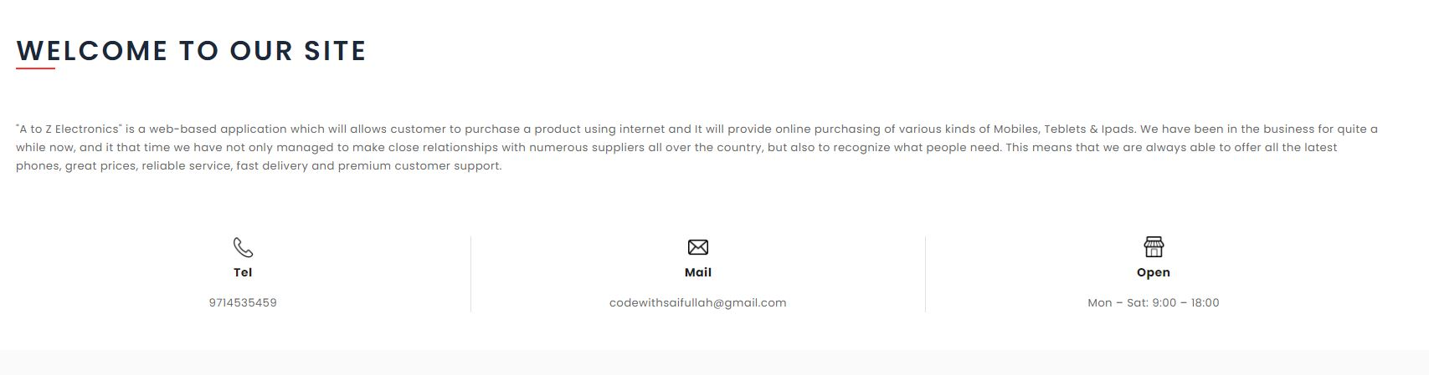
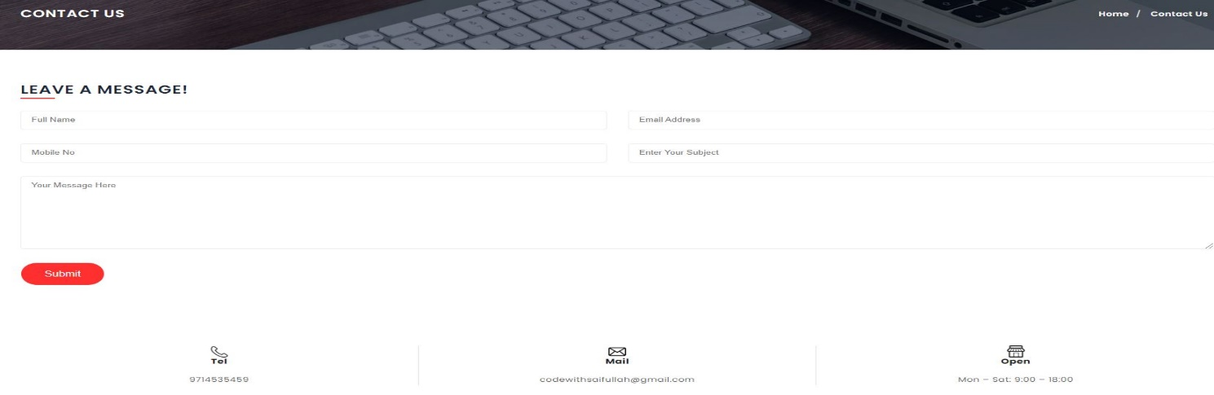
About Us
Contact Us

Slide 55
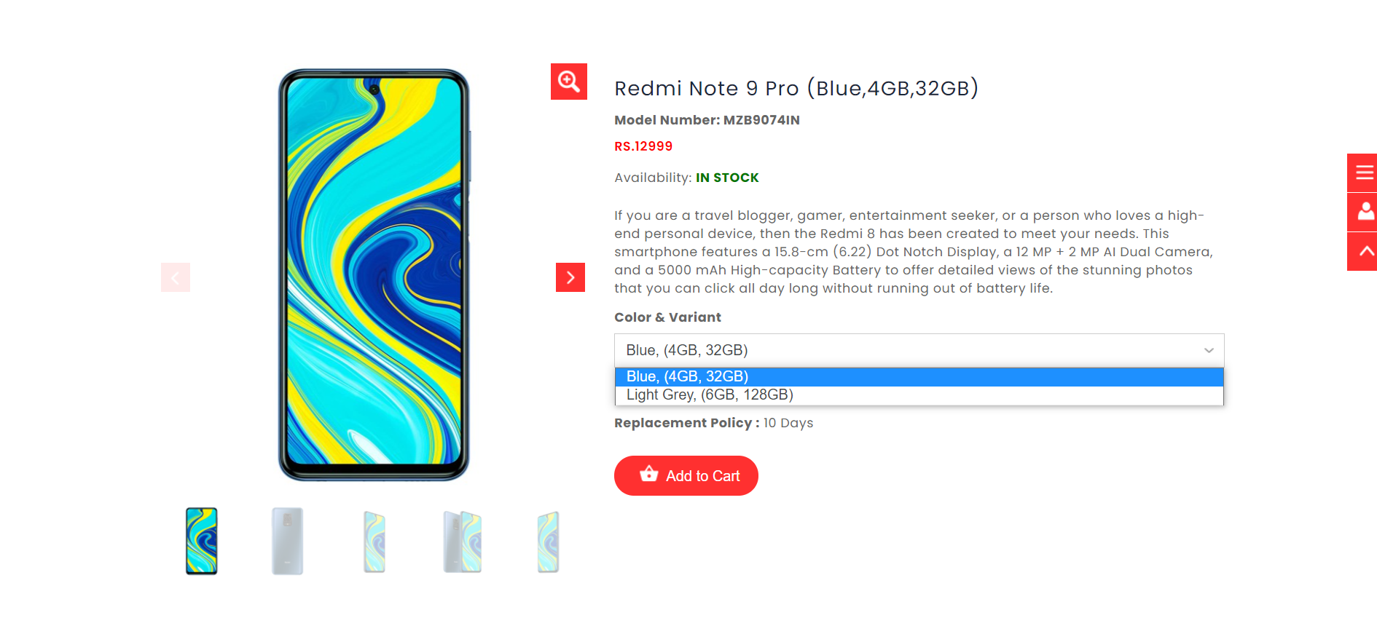
Product Details- I

Slide 56
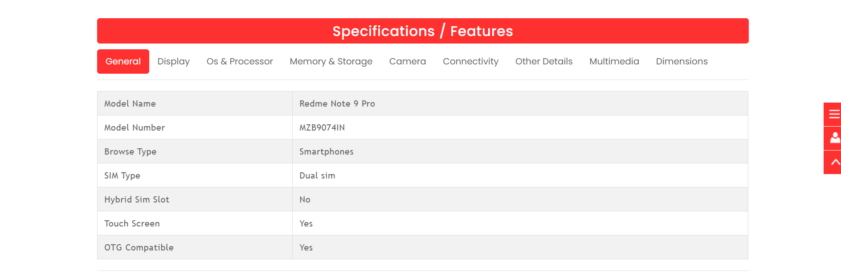
Product Details- II

Slide 57
Customer Screen
Layouts

Slide 58
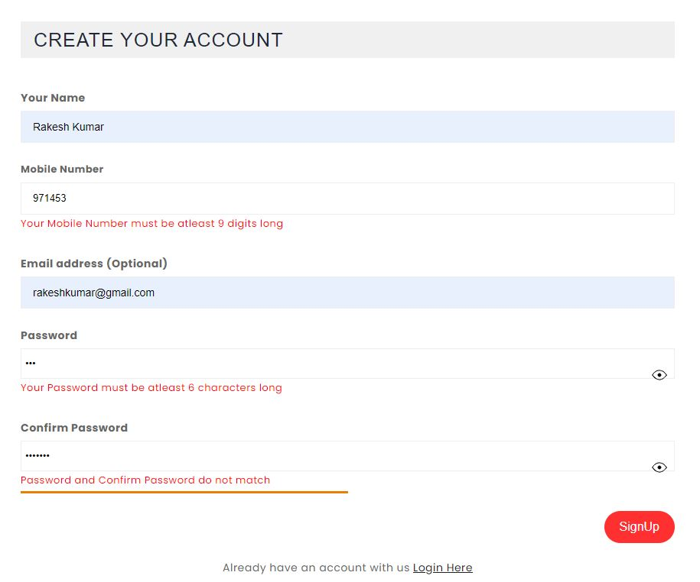
Customer Signup Form & Validation

Slide 59
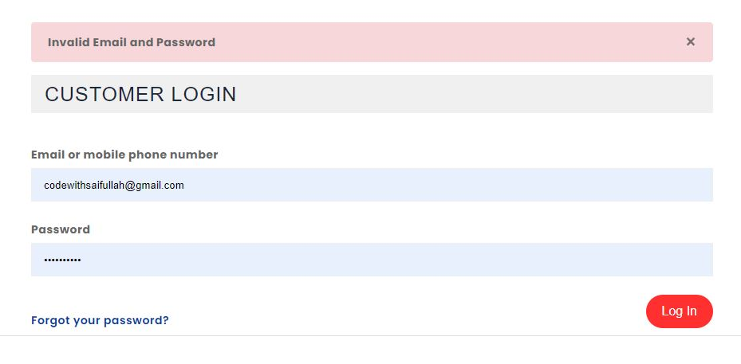
Customer Login Form & Validation

Slide 60
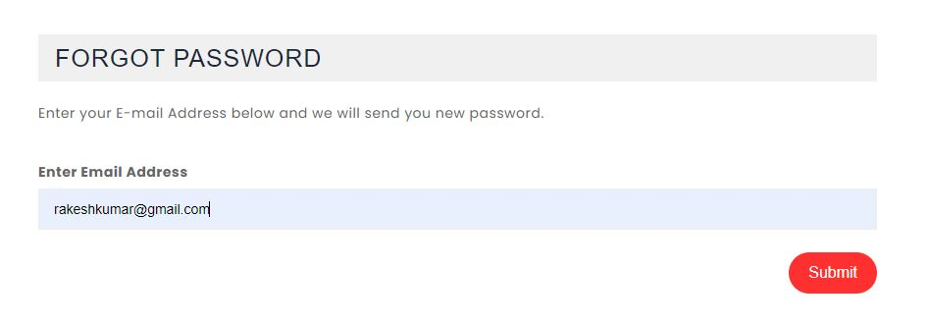
Forgot Password

Slide 61
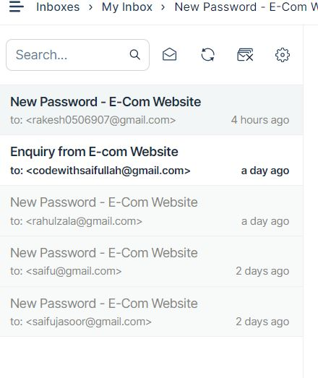
Mail Received

Slide 62
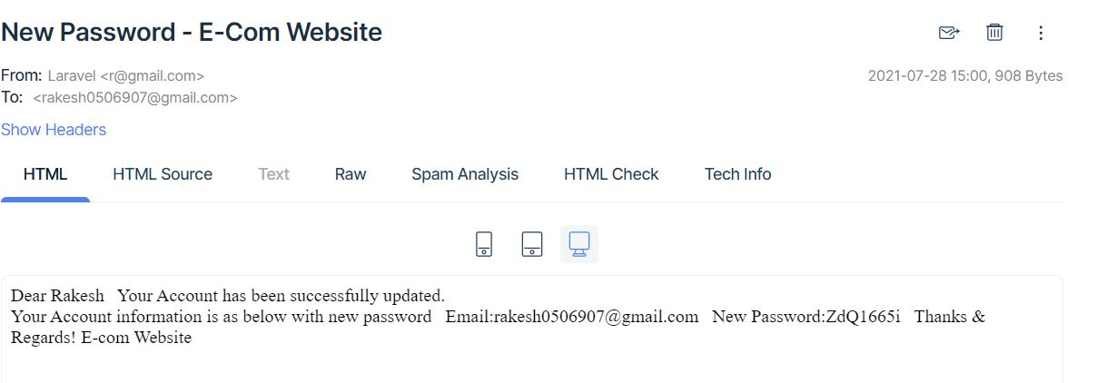
New Password Received

Slide 63
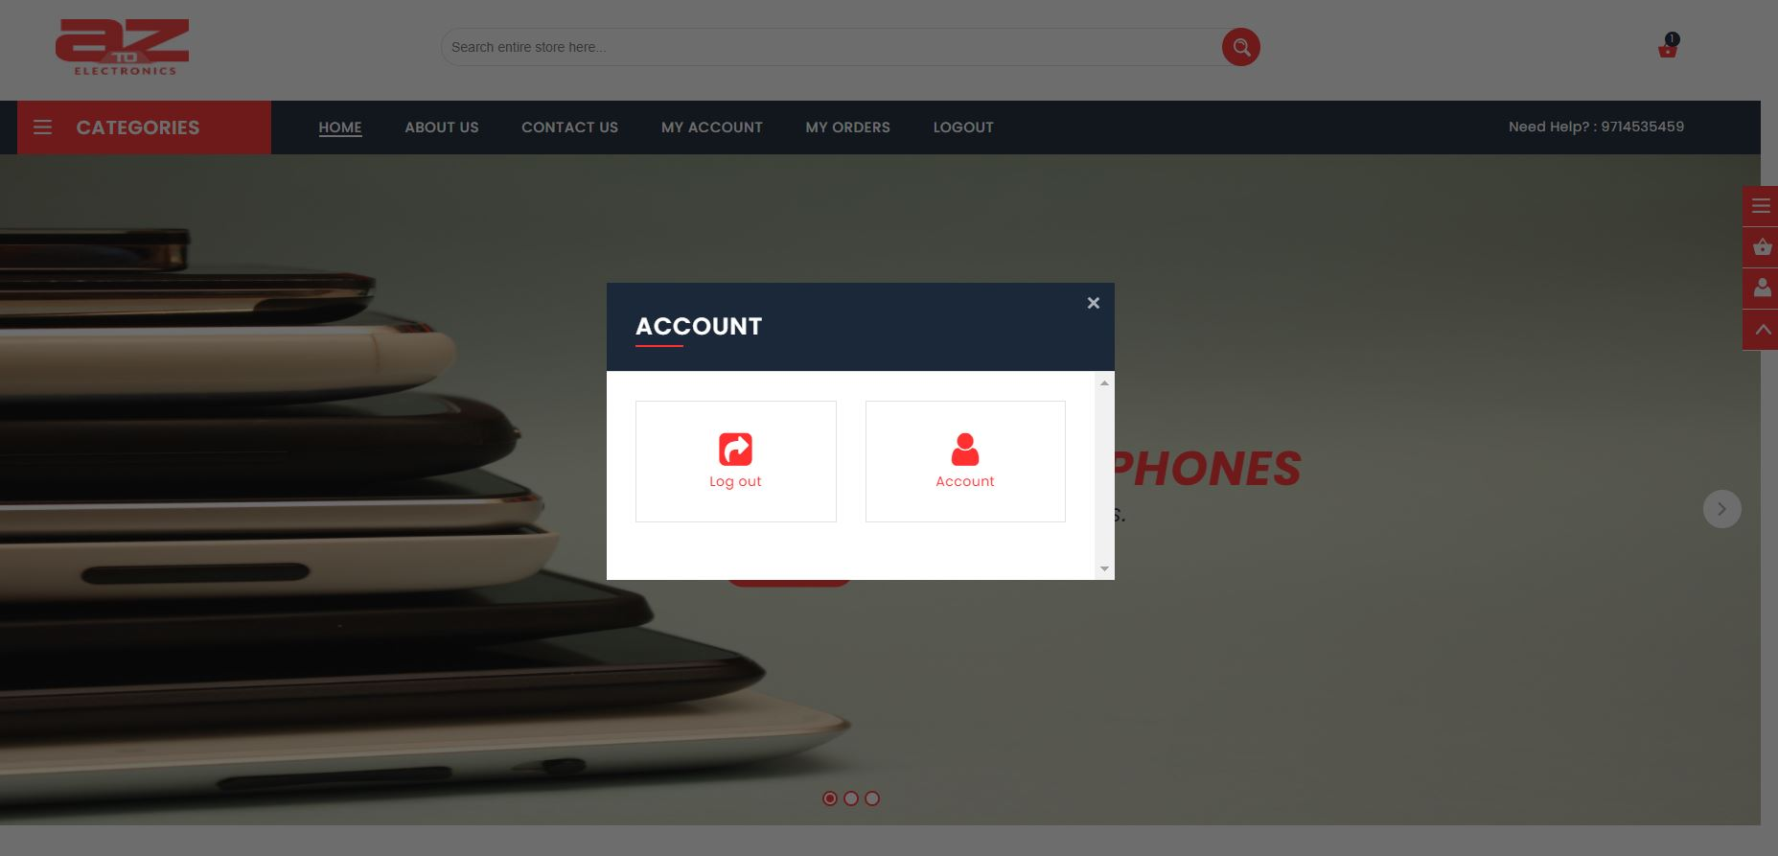
Home Page After Login

Slide 64
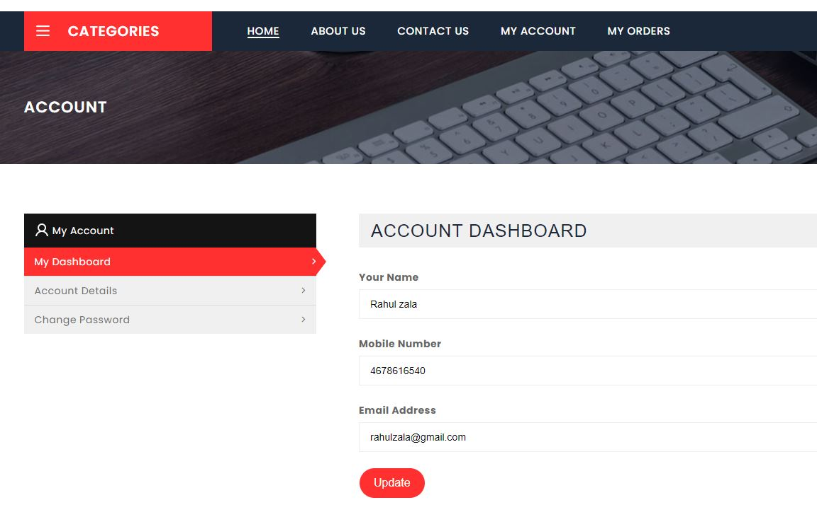
Customer Dashboard

Slide 65
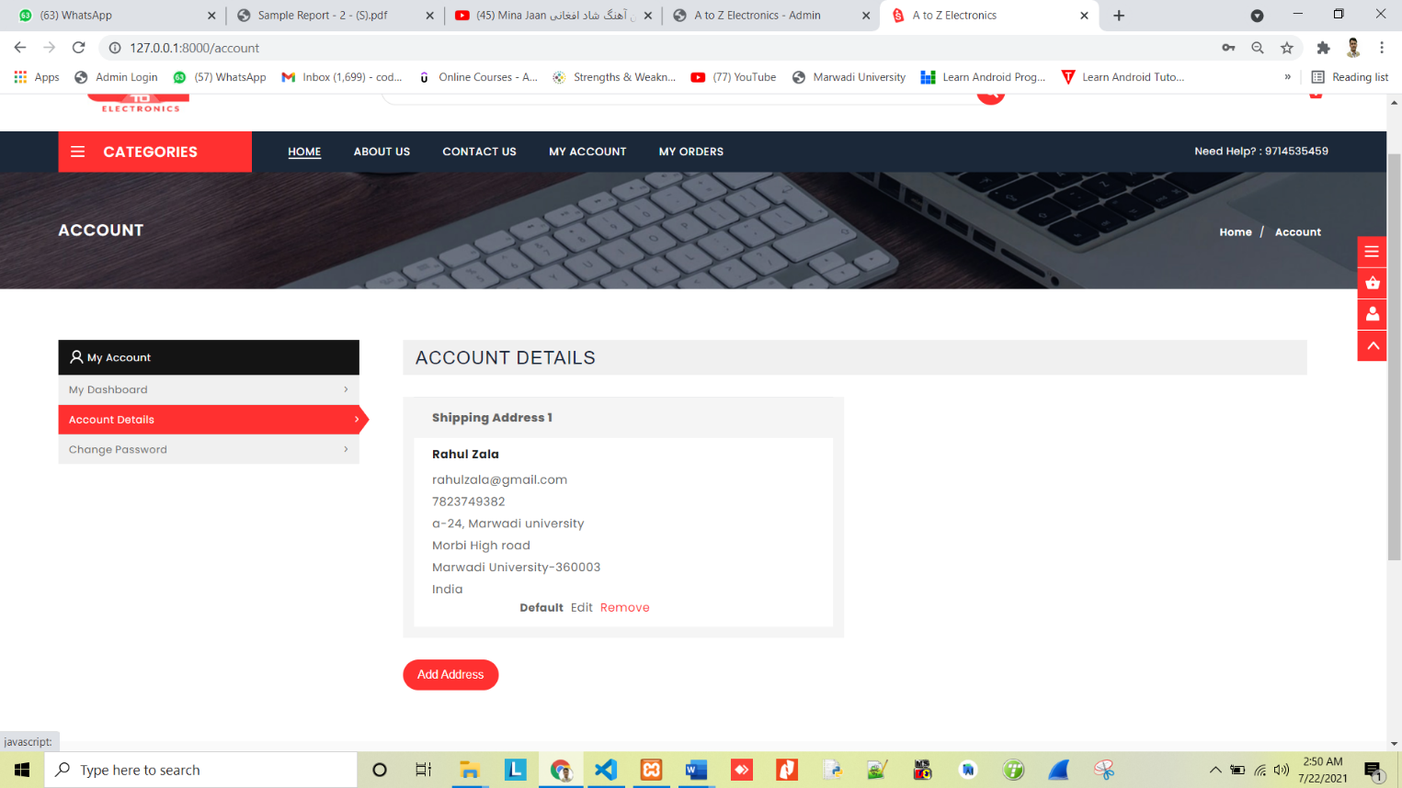
Account Details

Slide 66
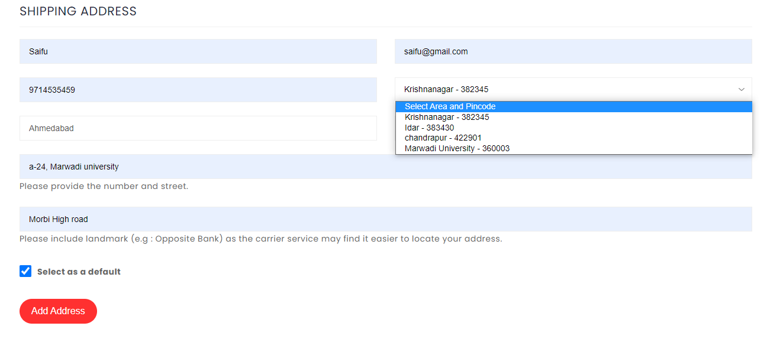
Add Shipping Address

Slide 67
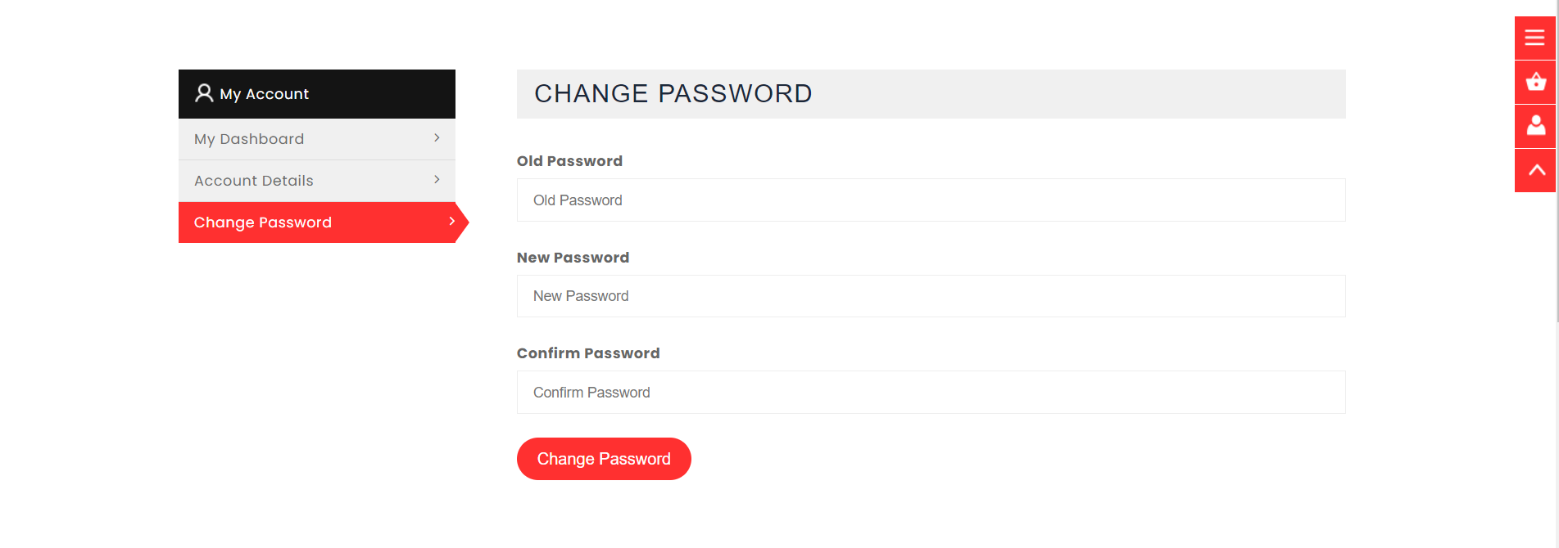
Change Password

Slide 68
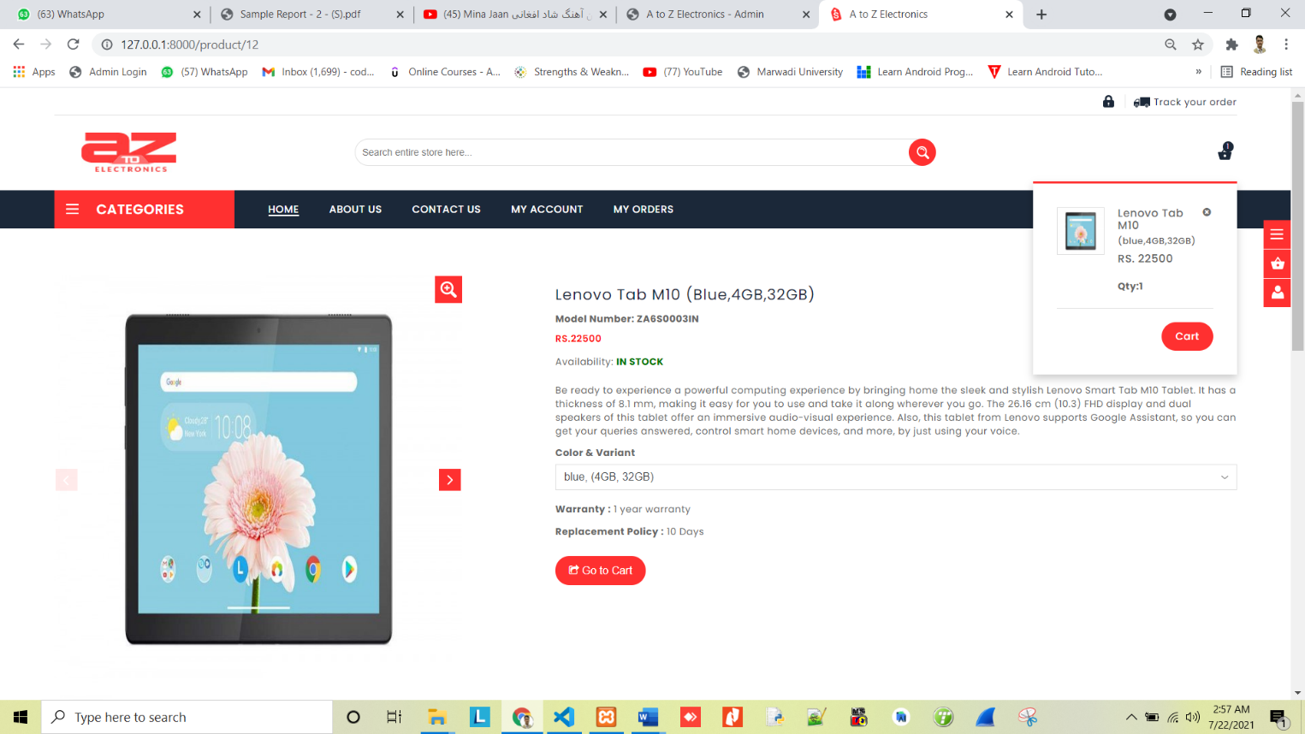
Product - Add to Cart

Slide 69
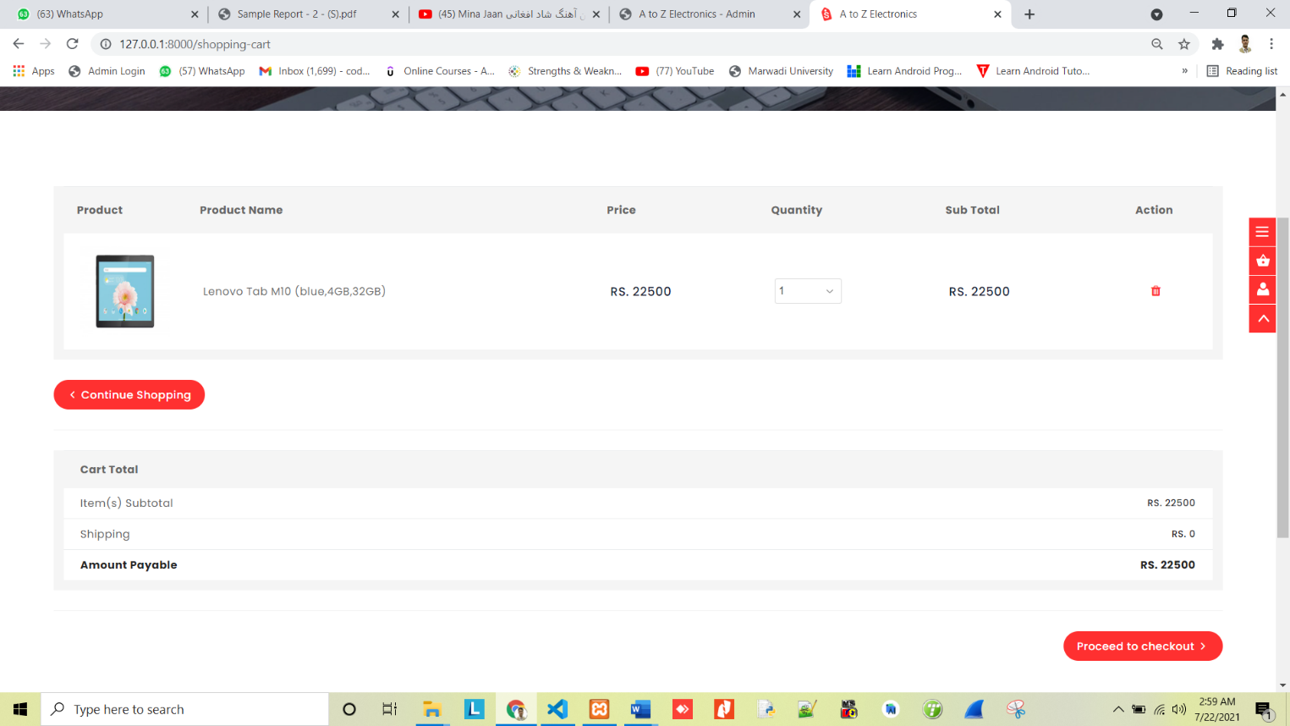
Shopping Cart

Slide 70
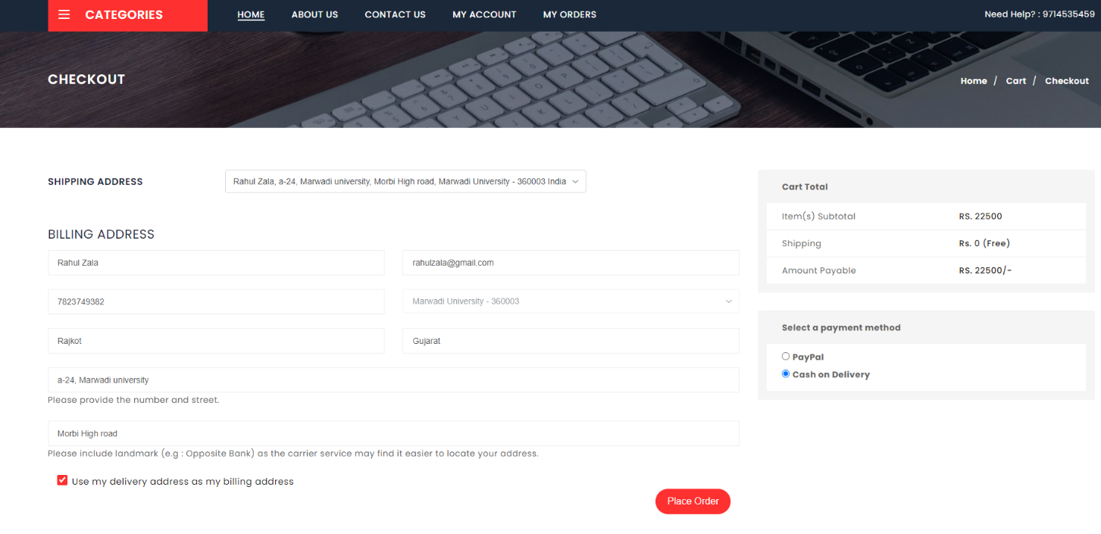
Checkout Page

Slide 71
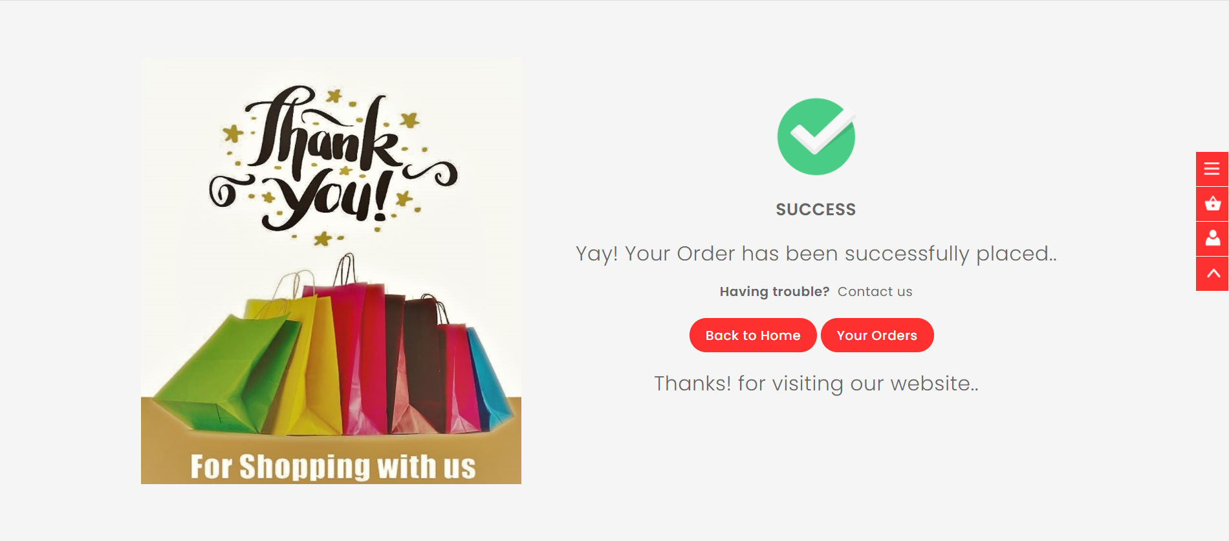
Order Placed Successfully – Thank you Page

Slide 72
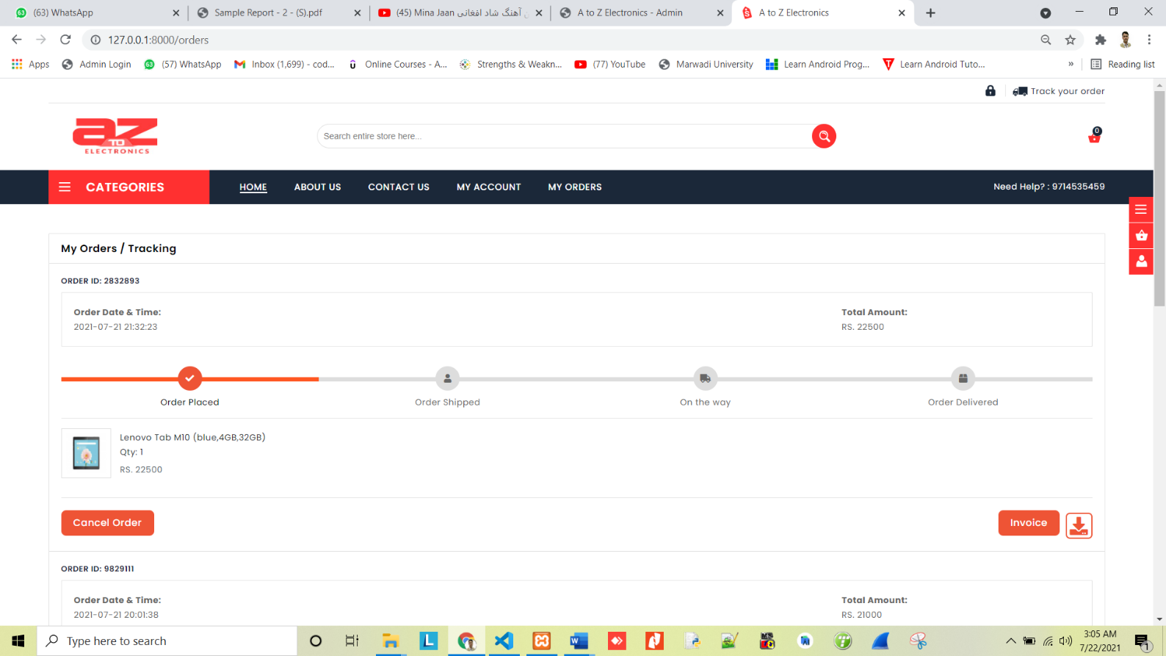
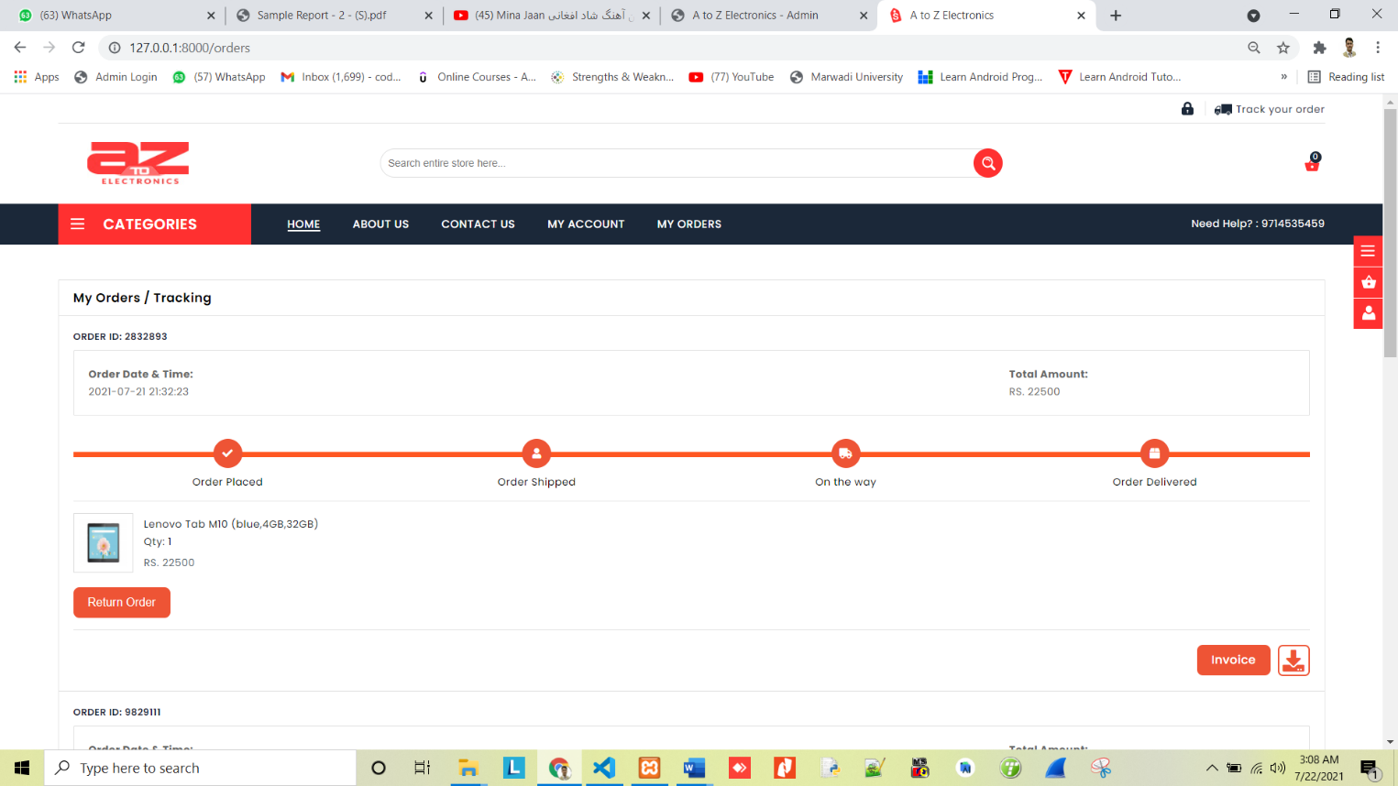
Placed Order – Tracking Details

Slide 73
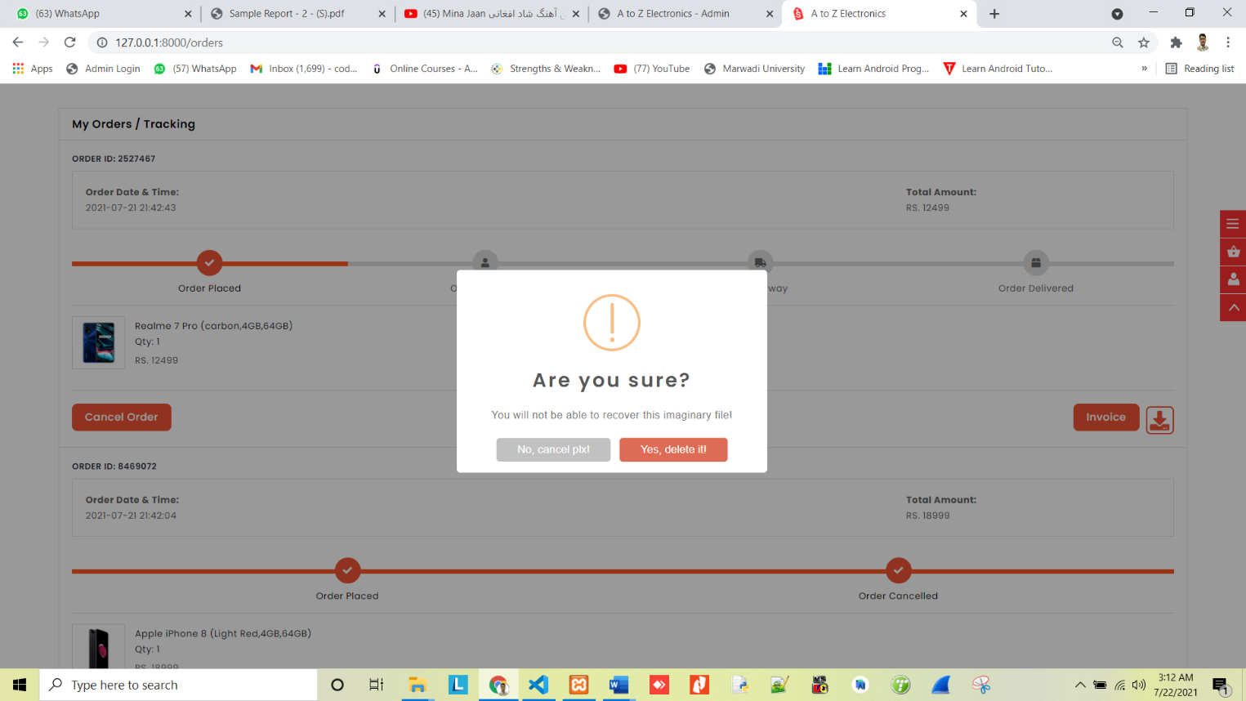
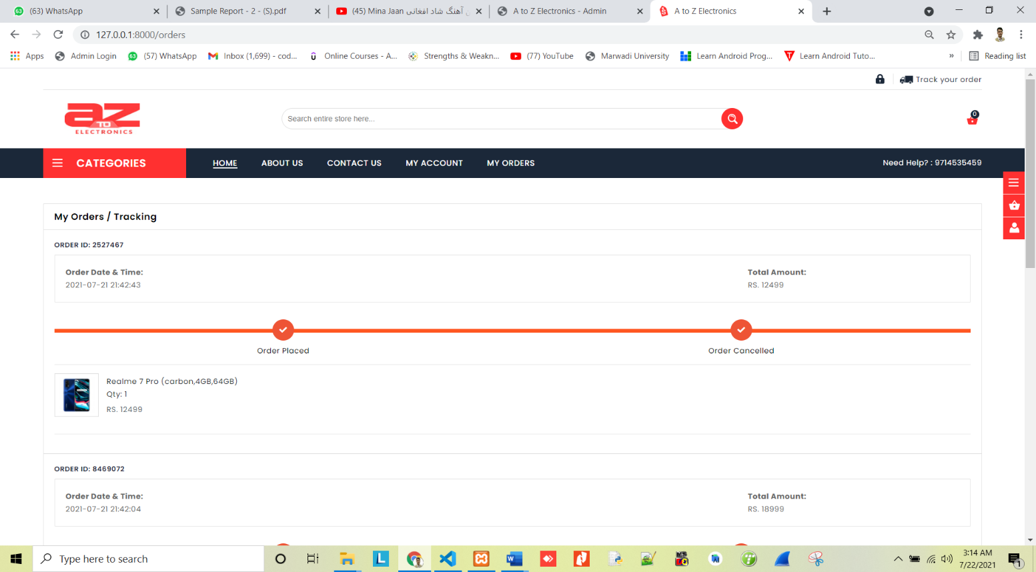
Cancel Order Confirmation Alert

Slide 74
Order Delivered

Slide 75
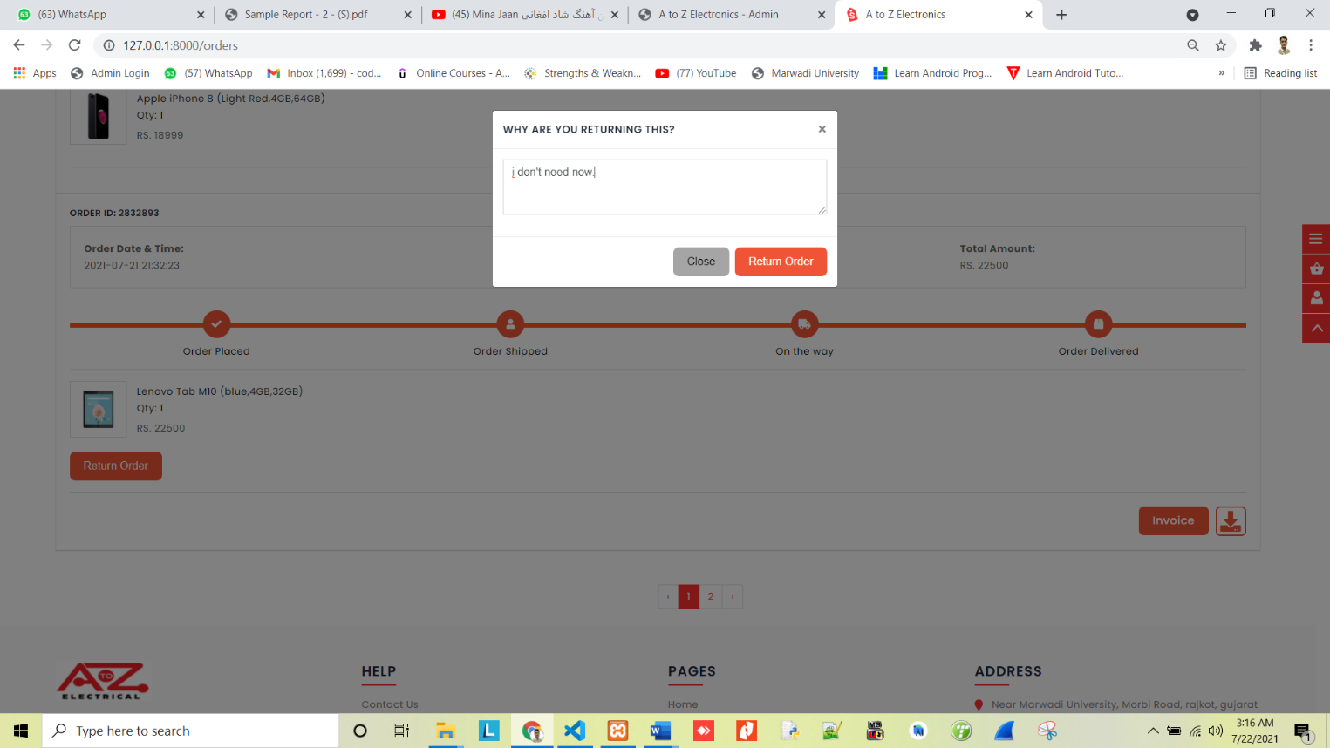
Modal For Return Order

Slide 76
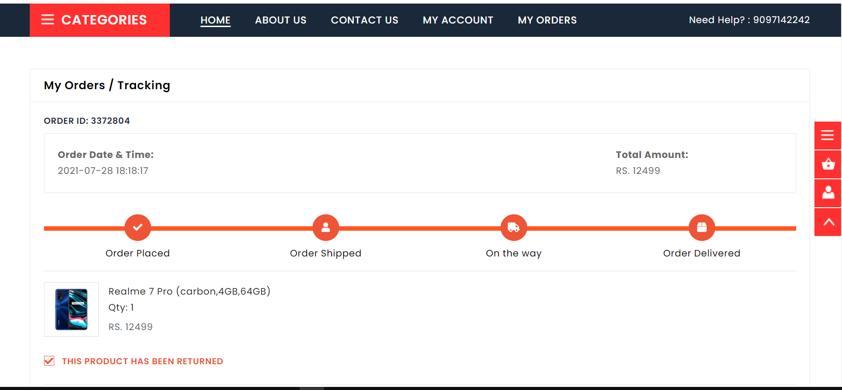
Product has been Returned

Slide 77
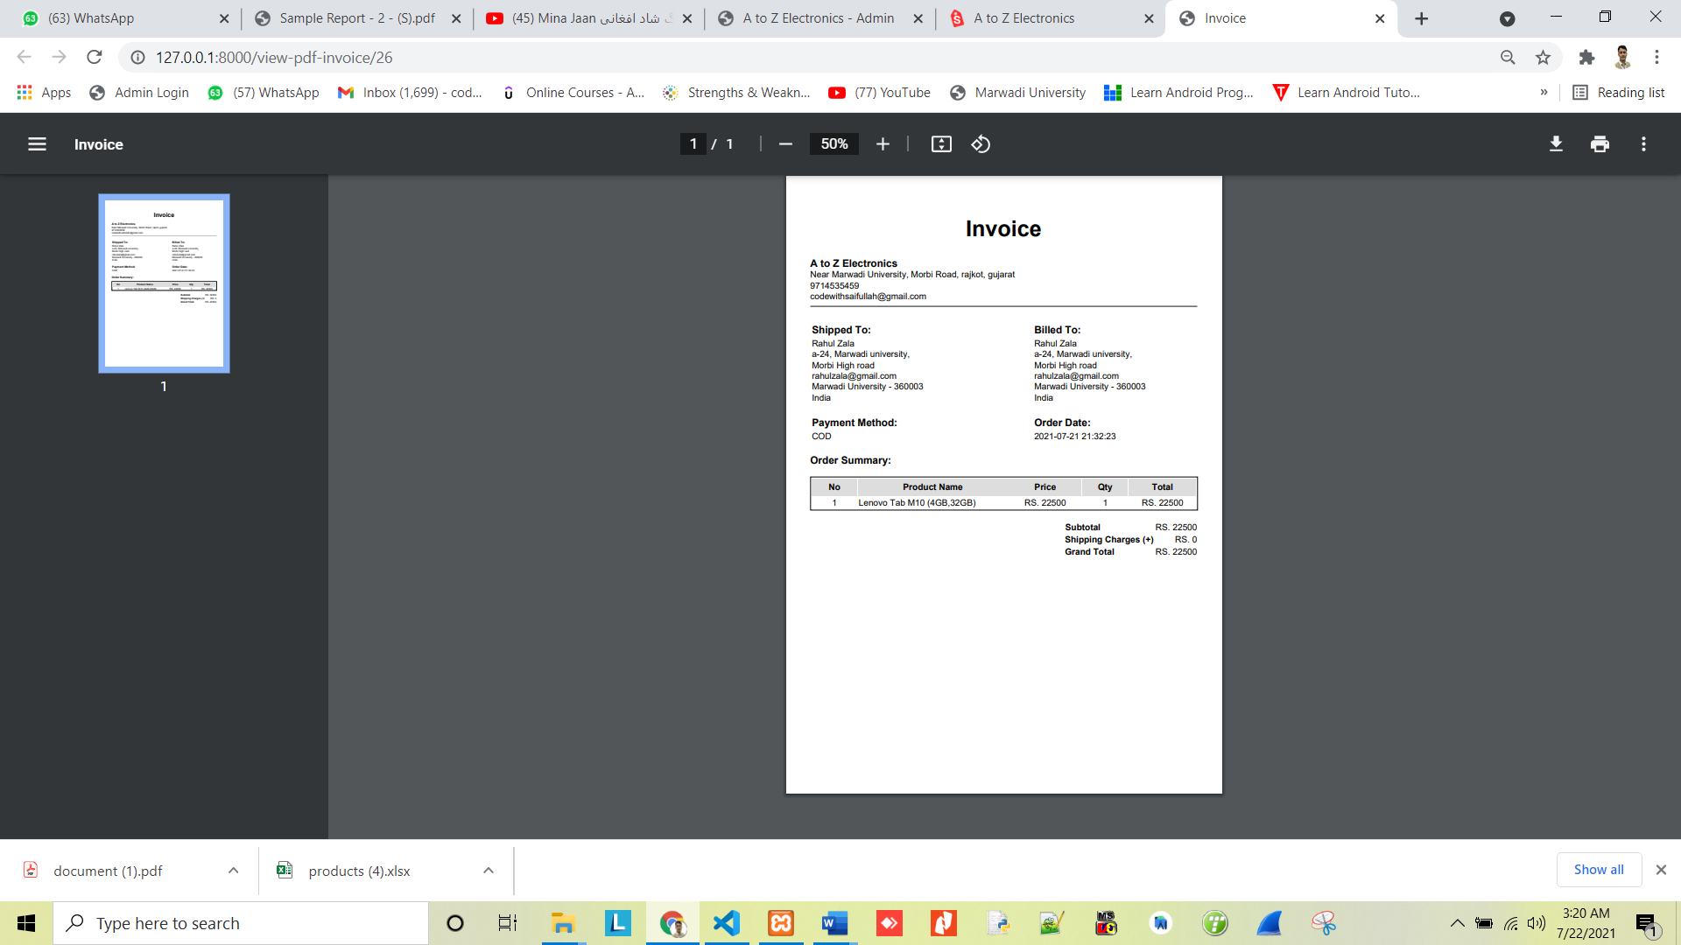
Invoice

Slide 78
Future Enhancement
We think that not a single project is ever considered as complete forever because our mind is always thinking new and our necessities also are growing. Our system Also, if you see at the first glance that you find it to be complete but we want to make it still mature and fully automatic like adding feedback & Rating an etc. The system is modified in future as per the owner requirement.

Slide 79
Conclusion
There may be some error or some defect in the work. we have taken enough care to make the project user friendly and more interactive. we have tried our level best to make the service useful and to provide maximum facility but never claim that this system may fulfil all requirement in every condition. Hereby conclude these reports which give information regarding the development and the user of application with an overview of different aspect of it.

Slide 80


